Slide 1
Office of Business, Industry, and Infrastructure Integration (OB3I)
Business Economic Analysis Data (BEAD) Tier 1 Report

Slide 2
TABLE OF CONTENTS
Purpose of the BEAD Tier 1 Report:
The intent of this report is to provide FEMA leadership with a high-level view of the potential economic and supply chain risks from the [Name of event/disaster].
The report aims to highlight critical infrastructure and industries that may be at risk, outline possible cascading impacts to industries, and consider the broader economic consequences of disruption.
The goal is to support decision-making by identifying where local damage could create national effects and what priorities may guide response and recovery.
Area of Interest: AOI(s) Hazard: Name of Disaster
Executive Summary
Hazard Overview
Event Footprint vs. U.S. Economy
Headliner Industries
Critical Infrastructure
Ripple Forecast
Socio-Economic Profile
Appendix

Slide 3
Executive Summary – [AOI] | [Hazard/Event Name]
Should answer:
What are the national/global-level economic/supply chain impacts of an incident?
What national and global economic/supply chain impacts should FEMA senior-leadership be aware of resulting from this incident?
What are the economic/industry interdependencies of a threat/hazard situation?
Notes:
The BLUF is a one or 2 sentence summary of the MOST IMPORTANT takeaways from this report.
Supporting bullets should summarize key takeaways from each of the slides, starting with the most important information at the top
Font should always be Franklin Gothic Book & never smaller than size 12, ideally size 14
BLUF can be one font size larger if there is room, but should always be bolded – needs to answer the “So what”
Sources: Update sources
Notes:
Should answer:
What are the national/global-level economic/supply chain impacts of an incident?
What national and global economic/supply chain impacts should FEMA senior-leadership be aware of resulting from this incident?
What are the economic/industry interdependencies of a threat/hazard situation?

Slide 4
Hazard Overview – [Type of Hazard Information Shown]
Key BLUF/takeaway statement summarizing the most important information on this slide (bolded, no period, no bullet) – needs to answer the “So what”
Supporting information or statistics
Never add periods to the end of bullets
Font should always be Franklin Gothic Book & never smaller than size 12, ideally size 14
Map comes from analysts - GeoCube/QGIS or authoritative weather source
Can be multiple slides if multiple hazard considerations – flood, wind, landslide, etc.
Timestamp information when we pulled hazard data.
Sources: Update sources
Notes:
Should Answer: What is the footprint and severity of a hazard/disaster? – defines our AOI

Slide 5
Area of Interest (Aggregation Levels)

Slide 6
Event Footprint vs. U.S. Economy: [AOI]
Key BLUF/takeaway statement summarizing the most important information on this slide (bolded, no period, no bullet) – needs to answer the “So what”
Key Takeaway(s):
Supporting information or statistics
Never add periods to the end of bullets
Font should always be Franklin Gothic Book & never smaller than size 12, ideally size 14
Table comes from running python notebook: _event_footprint.py
Share of Total US GDP
 | GDP (USD) | % of Total US GDP
AOI (State/Territory) | $X.XB (Yr of Data) | X.XX%
United States | $29T (2024) | 100%
Sources: Update sources

Slide 7
Headliner Industries (Total GDP): Guam
Key BLUF/takeaway statement summarizing the most important information on this slide (bolded, no period, no bullet) – needs to answer the “So what”
Supporting information or statistics
Never add periods to the end of bullets
Font should always be Franklin Gothic Book & never smaller than size 12, ideally size 14
Table comes from running python notebook: top_industry.py
Top 10 Industries by GDP (Year of Data): [AOI]
Industry | GDP in USD (% of total GDP)
Hotels and motels (incl. casino hotels) | $594M (7.62%)
Air transportation | $375M (4.81%)
Retail — food and beverage stores | $191M (2.45%)
Retail — clothing and accessories | $167M (2.14%)
Monetary authorities and banking | $141M (1.81%)
Construction — single-family residential | $141M (1.81%)
Retail — motor vehicle and parts dealers | $140M (1.79%)
Retail — general merchandise stores | $129M (1.65%)
Insurance agencies and brokerages | $116M (1.49%)
Retail — building material and garden supply | $102M (1.31%)
† Government as an industry was excluded from rankings.
Sources: Update sources
Notes:
Should Answer: What industries are concentrated in the area of impact that could have national security or widespread economic implications?

Slide 8
Headliner Industries (Employee Count): [AOI]
Key BLUF/takeaway statement summarizing the most important information on this slide (bolded, no period, no bullet) – needs to answer the “So what”
Supporting information or statistics
Never add periods to the end of bullets
Font should always be Franklin Gothic Book & never smaller than size 12, ideally size 14
Table comes from running python notebook: top_industry.py
Top 10 Industries by GDP (Year of Data): [AOI]
Industry | Total No. of Employees
Hotels and motels, including casino hotels | 8,290
Retail - Food and beverage stores | 3,892
Retail - Clothing and clothing accessories stores | 3,271
Full-service restaurants | 2,550
Construction of new single-family residential structures | 2,334
Retail - General merchandise stores | 2,117
Scenic and sightseeing transportation and support activities for transportation | 2,040
Retail - Miscellaneous store retailers | 1,874
Retail - Motor vehicle and parts dealers | 1,594
Other real estate | 1,591
† Government as an industry was excluded from rankings.
Sources: Update sources
Notes:
Should Answer: What industries are concentrated in the area of impact that could have national security or widespread economic implications?

Slide 9
Critical Infrastructure & Commodity Flows: [AOI]
Key BLUF/takeaway statement summarizing the most important information on this slide (bolded, no period, no bullet) – needs to answer the “So what”
Supporting information or statistics
Never add periods to the end of bullets
Font should always be Franklin Gothic Book & never smaller than size 12, ideally size 14
Notes: Maps are created by analysts using layers from GeoCube & QGIS
What is being mapped will likely change depending on AOI, but key layers to show are. May need more than one map/slide.
Airports
Ports
Highways
Critical power infrastructure (power plants, terminals, pipeline)
Key businesses for commodity flows (ie, large distributors)
Sources: Update sources
Notes:
Should Answer: What goods generally flow through (or originate and terminate in) the impacted area? What freight modes are used?

Slide 10
Ripple Forecast: [AOI]
Supply Chain Context: Key BLUF/takeaway statement summarizing the most important information on this slide (bolded, no period, no bullet) – needs to answer the “So what”
Note: Map or chart is not standardized for this one – could be a slide that may only be text if we do not have a good visualization
Potential Impact Timeline
0–3 Days (Plain Language Situational Status)
Supporting information or statistics
Never add periods to the end of bullets
Font should always be Franklin Gothic Book & never smaller than size 12, ideally size 14
3–7 Days (Plain Language Situational Status)
Supporting information or statistics
Never add periods to the end of bullets
Font should always be Franklin Gothic Book & never smaller than size 12, ideally size 14
7+ Days (Plain Language Situational Status)
Supporting information or statistics
Never add periods to the end of bullets
Font should always be Franklin Gothic Book & never smaller than size 12, ideally size 14
Sources: Update sources
Notes:
Should Answer: What forecasted impacts can the U.S. national economy expect over the next 3 days, 2 weeks, and 3 months as a result of this incident?

Slide 11
Socio-Economic Profile: [AOI]
Key BLUF/takeaway statement summarizing the most important information on this slide (bolded, no period, no bullet)
Supporting information or statistics
Never add periods to the end of bullets
Font should always be Franklin Gothic Book & never smaller than size 12, ideally size 14
Table comes from running python notebook: socio_demo.py
Can also include CRCI information if available
Socio-demographics Information (Yr of Data): [AOI]
 | Number of people | % of Population
Total Population for Guam | 153,836 | 100%
Population Under Age 5 | 10,626 | 6.9%
Population Under Age 18 | 41,487 | 27.0%
Population 65 and Over | 9,211 | 6.0%
Population with a Disability* | 19,086 | 13.3%
Education level below High School Diploma* | 12,773 | 14.0%
Unemployed* | 6,570 | 5.9%
*excluding military housing units
Sources: Update sources
Notes:
Should Answer: Are there any notable socio-economic indicators relevant to the population impacted by a given incident?
Need to look into updating demographic data & name any limitations – especially with territories

Slide 12
Appendix

Slide 13
Data Sources
Source | Link | Use Case
Name of source | Link to source | How was the source used in analysis?
Notes: Can go down to size 9 font, but if more room is needed, start another Data Sources slide

Slide 14
BEAD Tier 1 Example: Guam

Slide 15
Super Typhoon Sinlaku: Guam and Commonwealth of Northern Mariana Islands
Office of Business, Industry, and Infrastructure Integration (OB3I)
Business Economic Analysis Data (BEAD) Tier 1 Report

Slide 16
Executive Summary – Guam and CNMI | Typhoon Sinlaku
Sinlaku is forecast to impact Guam and CNMI as a Category 3 typhoon (~120 mph) on April 13. Both territories are expected to enter a constrained supply chain environment driven by port disruption. While short-term food and fuel supplies are adequate, delayed shipments, power outages, and communications disruptions will limit distribution, access, and recovery, particularly in CNMI due to inter-island dependencies.
Sinlaku is forecast to impact Guam and CNMI as a Category 3 typhoon (~120 mph), bringing high winds, 15–20 inches of rain, coastal flooding, and tropical storm conditions.
Guam and CNMI are entering a constrained resupply period, with port operations degrading and limited ability to receive near-term shipments. Recent deliveries (Apr 6–8 cargo; late March fuel) provide short-term supply, but upcoming shipments (Apr 12–19 cargo; mid-April fuel tanker) are at risk if conditions escalate.
Both territories are fully dependent on maritime imports for food and fuel, making port operability the primary driver of resupply timing and retail availability. Power outages are a key risk multiplier, with potential impacts to fuel distribution and food spoilage, especially for refrigerated goods.
CNMI faces elevated risk due to its multi-island structure: Saipan serves as the primary hub, while Tinian and Rota rely on more vulnerable inter-island transport. Impacts are expected to manifest as delays and localized shortages, not immediate depletion.
Guam has significant military and strategic infrastructure exposure, including Naval Base Guam, Andersen Air Force Base, and Camp Blaz, as well as its role as a trans-Pacific communications hub.
While Sinlaku is expected to be less severe than Super Typhoon Mawar (2023), that event demonstrated the potential for widespread infrastructure disruption ($338M FEMA assistance; ~$10B DoD repairs) and prolonged lifeline impacts.
Since Mawar, Guam’s power system resilience has improved through grid hardening, undergrounding, and the addition of the 198 MW Ukudu power plant, though systems remain dependent on imported fuel and functional port operations.
Sources: NOAA / NWS Guam; FEMA Western Pacific IAB; Port Authority of Guam; Guam & CNMI SCAN Baseline Assessments
Notes:
Should answer:
What are the national/global-level economic/supply chain impacts of an incident?
What national and global economic/supply chain impacts should FEMA senior-leadership be aware of resulting from this incident?
What are the economic/industry interdependencies of a threat/hazard situation?

Slide 17
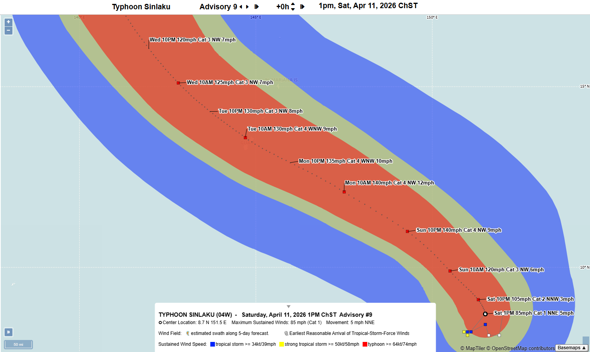
Hazard Overview – Typhoon Sinlaku Winds
Expected Hazard Timing & Impacts
Guam (Primary Impact Area):
Typhoon-force winds expected Monday–Tuesday (Apr 13–14 EST)
Potential intensity: Category 3–4 (~120–130 mph sustained)
Highest risk for infrastructure damage, power outages, and port disruption
CNMI (Secondary Impact Area):
Rota: Strong tropical storm to near-typhoon conditions
Tinian & Saipan: Tropical storm-force winds with heavy rainfall
Impacts likely focused on transportation, power, and inter-island movement
Based on JTWC Advisory 9 (Chamorro Standard Time (ChST) is 14 hours ahead of Eastern Daylight Time (EDT))
Commonwealth of
Northern Mariana Islands
Guam
Sources: NOAA / NWS Guam; HURREVAC
Notes:
Should Answer: What is the footprint and severity of a hazard/disaster? – defines our AOI

Slide 18
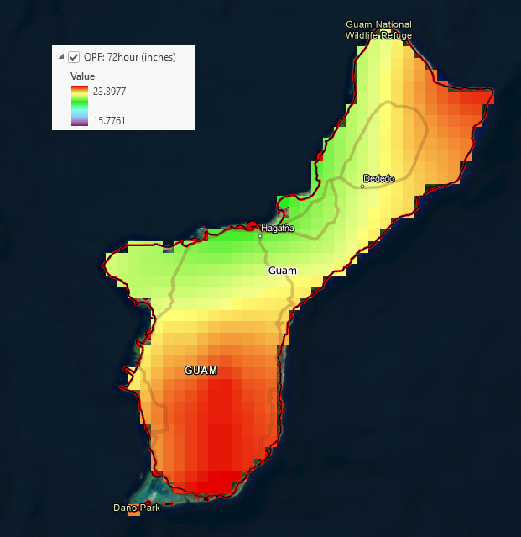
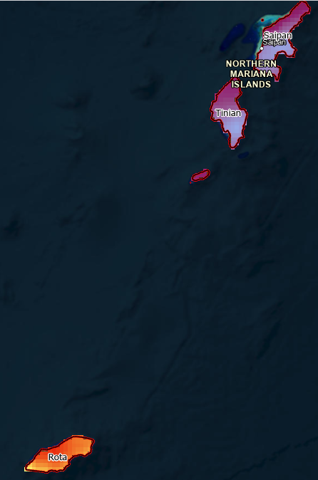
Hazard Overview – Typhon Sinlaku Precipitation
Expected Rainfall & Secondary Hazards
Guam & Rota:
15–20 inches of rainfall (Sunday night–Wednesday)
Saipan & Tinian:
8–15 inches of rainfall
Highest rainfall concentrations expected in central and southern Guam, increasing risk of localized impacts.
Flash floods and mudslides over central to southern Guam are possible.
Sources: NOAA / NWS Guam – National Blend of Models (NBM) Quantitative Precipitation Forecast (QPF) 72-hour cumulation

Slide 19
Guam

Slide 20
Event Footprint vs. U.S. Economy: Guam
Guam ≈ 0.027% of U.S. GDP — economic disruption will not ripple into national supply chains or U.S. financial markets.
Guam has zero domestic fuel or food production — 100% of both arrive by sea, making port operability the single most critical recovery variable.
Federal military bases on Guam contribute 16% of total GDP, but their importance to national security exceeds their dollar contribution to the local economy.
Key Takeaway:
A typhoon poses no threat to U.S. macroeconomic stability — its economic footprint is nationally negligible.
No domestic fuel production and minimal food production; nearly all essential commodities arrive by sea, making the port the single point of failure.
Port clearance and seaborne resupply of fuel and food are required to restore economic activity; local recovery capacity is limited without external support.
Share of Total US GDP
 | GDP (USD) | % of Total US GDP
Guam | $6.3B (2019) | 0.027%
United States | $29T (2024) | 100%
Sources: IMPLAN – Data from 2019 for Guam and CNMII
Notes:
Should answer: Relative to the entire nation, how drastic will the impact be to the U.S. economy as a result of this incident?

Slide 21
Headliner Industries (Total GDP): Guam
Guam's private economy is concentrated in two sectors - tourism (hotels + air transport) and retail trade.
Of the top 10 industries, food and beverage retail and building material and garden supply retail are the most operationally critical, serving as the primary channels for food distribution and reconstruction materials; both depend entirely on restored port operations for resupply.
No critical infrastructure industries - power generation, water systems, fuel distribution, healthcare, or communications - appear in the top 10 private industries; those sectors operate largely outside the market economy through government or regulated utilities and are not captured here.
Key Takeaways:
The private economy is overwhelmingly tourism and retail - neither sector generates revenue during or immediately after a typhoon, meaning there is no private-sector financial cushion to absorb recovery costs; federal support is the only near-term stabilization mechanism.
The retail-heavy industry mix means Guam's economy restarts only when import supply chains restart - port clearance is not just a logistics priority, it is the economic recovery trigger.
Construction ranked 6th prior to impact; post-typhoon rebuilding demand is expected to exceed local capacity, requiring outside contractor mobilization and increased material throughput through the port.
Top 10 Industries by GDP (2019): Guam
Industry | GDP in USD (% of total GDP)
Hotels and motels (incl. casino hotels) | $594M (7.62%)
Air transportation | $375M (4.81%)
Retail — food and beverage stores | $191M (2.45%)
Retail — clothing and accessories | $167M (2.14%)
Monetary authorities and banking | $141M (1.81%)
Construction — single-family residential | $141M (1.81%)
Retail — motor vehicle and parts dealers | $140M (1.79%)
Retail — general merchandise stores | $129M (1.65%)
Insurance agencies and brokerages | $116M (1.49%)
Retail — building material and garden supply | $102M (1.31%)
† Government as an industry was excluded from rankings.
Sources: IMPLAN – Data from 2019 for Guam and CNMII
Notes:
Should Answer: What industries are concentrated in the area of impact that could have national security or widespread economic implications?

Slide 22
Headliner Industries (Employee Count): Guam
The top 10 by employment is dominated by tourism and hospitality.
Of the 10 industries, only food and beverage retail has direct and immediate relevance to civilian disaster response - as the primary workforce responsible for restocking and operating the stores that feed the population once resupply arrives.
Construction is the only other industry with recovery relevance, but post-typhoon rebuilding demand will far outpace this existing local capacity.
Key Takeaways:
This industry list confirms Guam's private economy offers minimal built-in response capacity - no manufacturing, no energy production, no logistics infrastructure ranks in the top 10.
The two privately-operated industries most relevant to civilian recovery - food retail and building supply - are restock-dependent businesses with no production capacity of their own; restoring their function is a port clearance problem, not a local industry problem.
Workforce capacity is constrained; response and recovery operations depend on imported labor and external contractor mobilization.
Top 10 Industries by GDP (2019): Guam
Industry | Total No. of Employees
Hotels and motels, including casino hotels | 8,290
Retail - Food and beverage stores | 3,892
Retail - Clothing and clothing accessories stores | 3,271
Full-service restaurants | 2,550
Construction of new single-family residential structures | 2,334
Retail - General merchandise stores | 2,117
Scenic and sightseeing transportation and support activities for transportation | 2,040
Retail - Miscellaneous store retailers | 1,874
Retail - Motor vehicle and parts dealers | 1,594
Other real estate | 1,591
† Government as an industry was excluded from rankings.
Sources: IMPLAN – Data from 2019 for Guam and CNMII
Notes:
Should Answer: What industries are concentrated in the area of impact that could have national security or widespread economic implications?

Slide 23
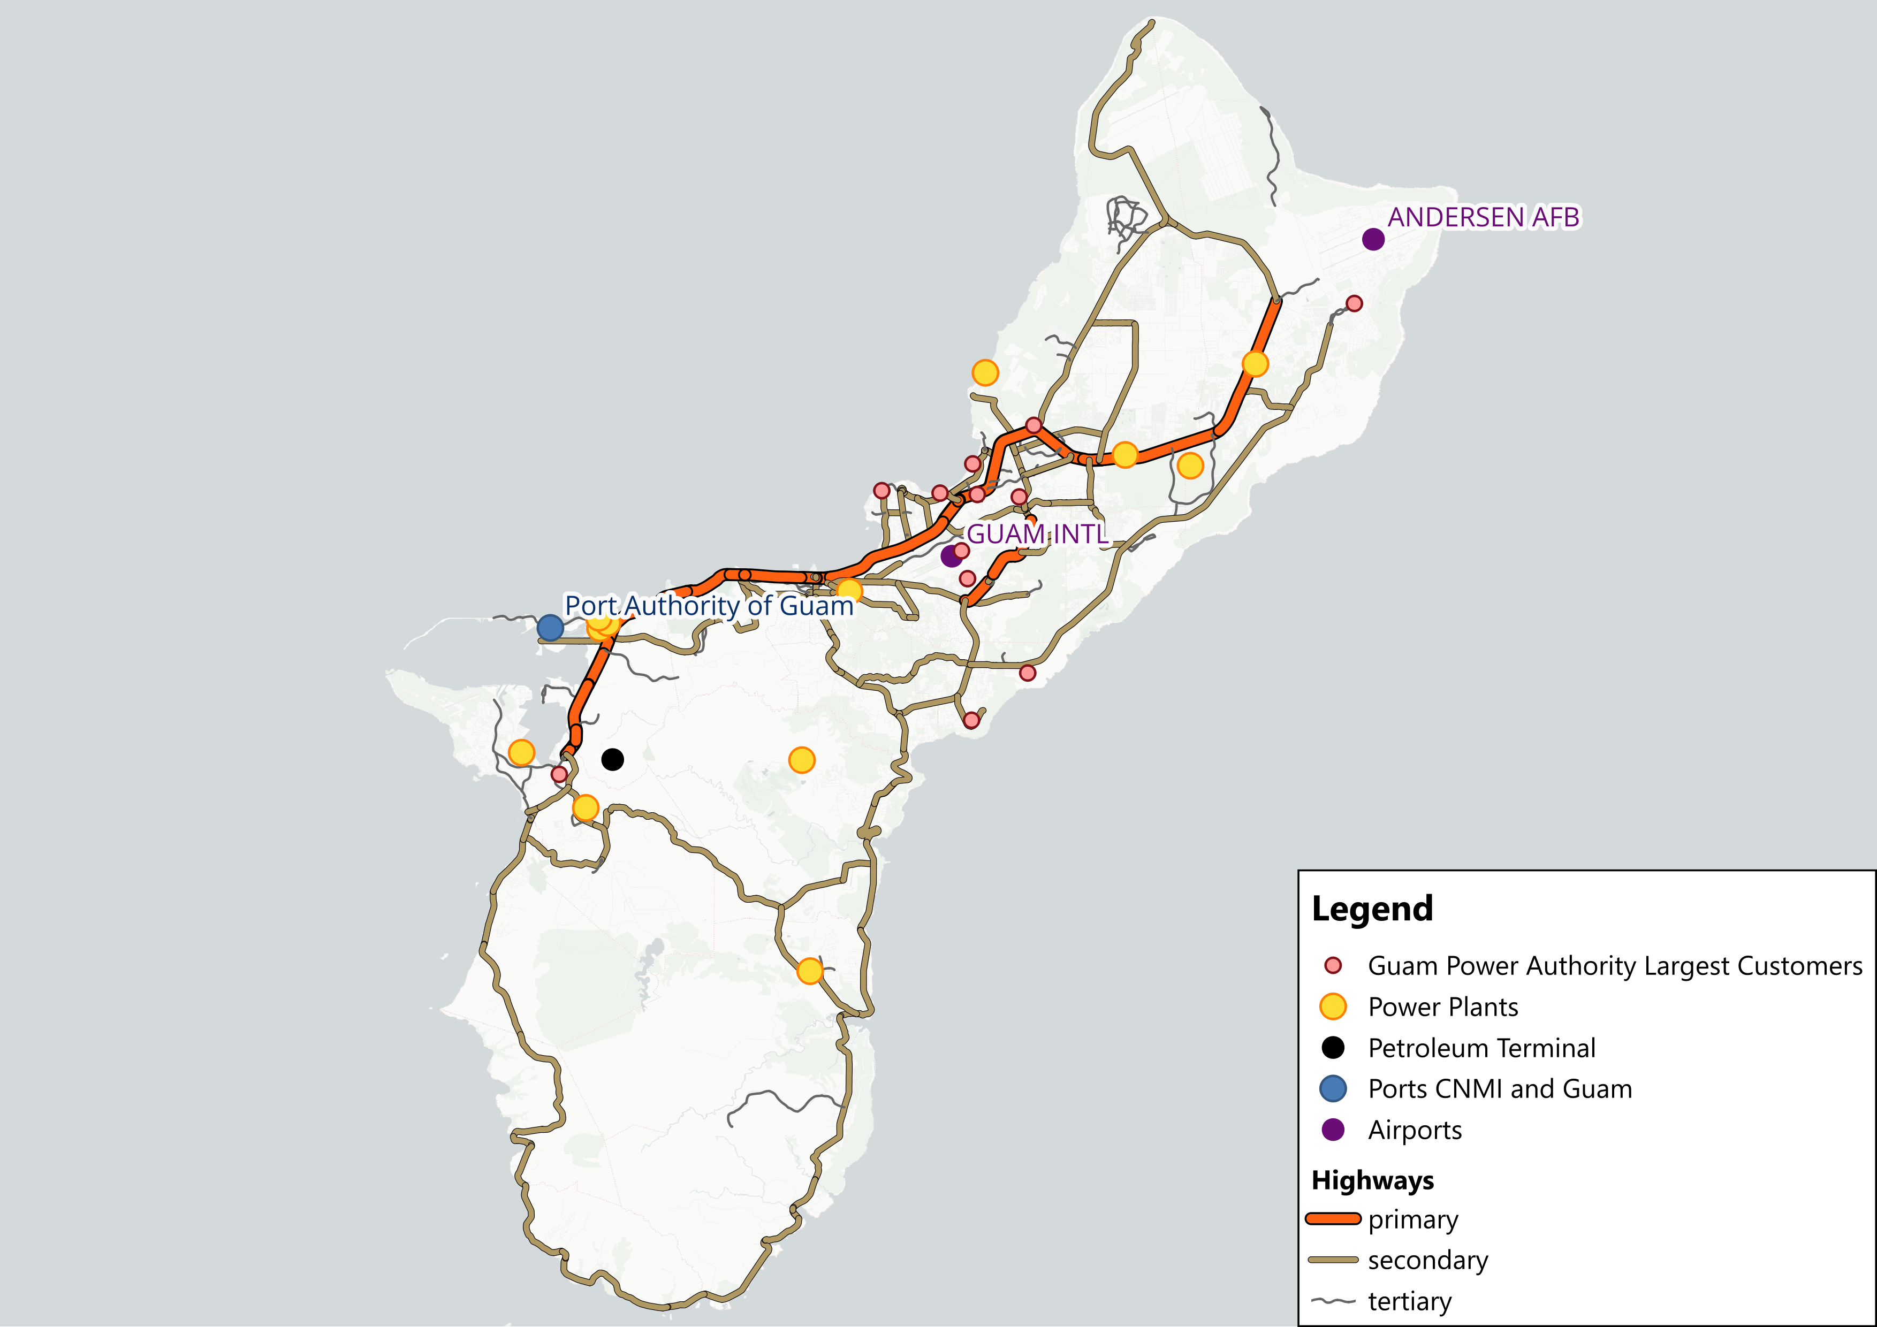
Critical Infrastructure & Commodity Flows: Fuel
Guam
The Port of Guam moved to Condition X-Ray (Apr 10), with cargo operations slowing and potential escalation to full closure within 24–48 hours.
Recent fuel shipments:
Gas Quest — Mar 24 (17:42 ChST)
Ardmore — Mar 26 (21:00 ChST)
Next scheduled fuel shipment:
Zhuo Hang Guang — Apr 18
Fuel supply posture:
~60 days of fuel for power generation (Guam Power Authority planning basis)
Key risk:
No immediate shortage expected; however, missed tanker offload or port closure could delay replenishment and compress distribution timelines
Power outages will constrain fuel pumping and distribution.
Sources: Port Authority of Guam; U.S. Coast Guard; Vessel AIS (MarineTraffic/VesselFinder); DOE Territory Energy Profile – Guam
Notes:
Should Answer: What goods generally flow through (or originate and terminate in) the impacted area? What freight modes are used?

Slide 24
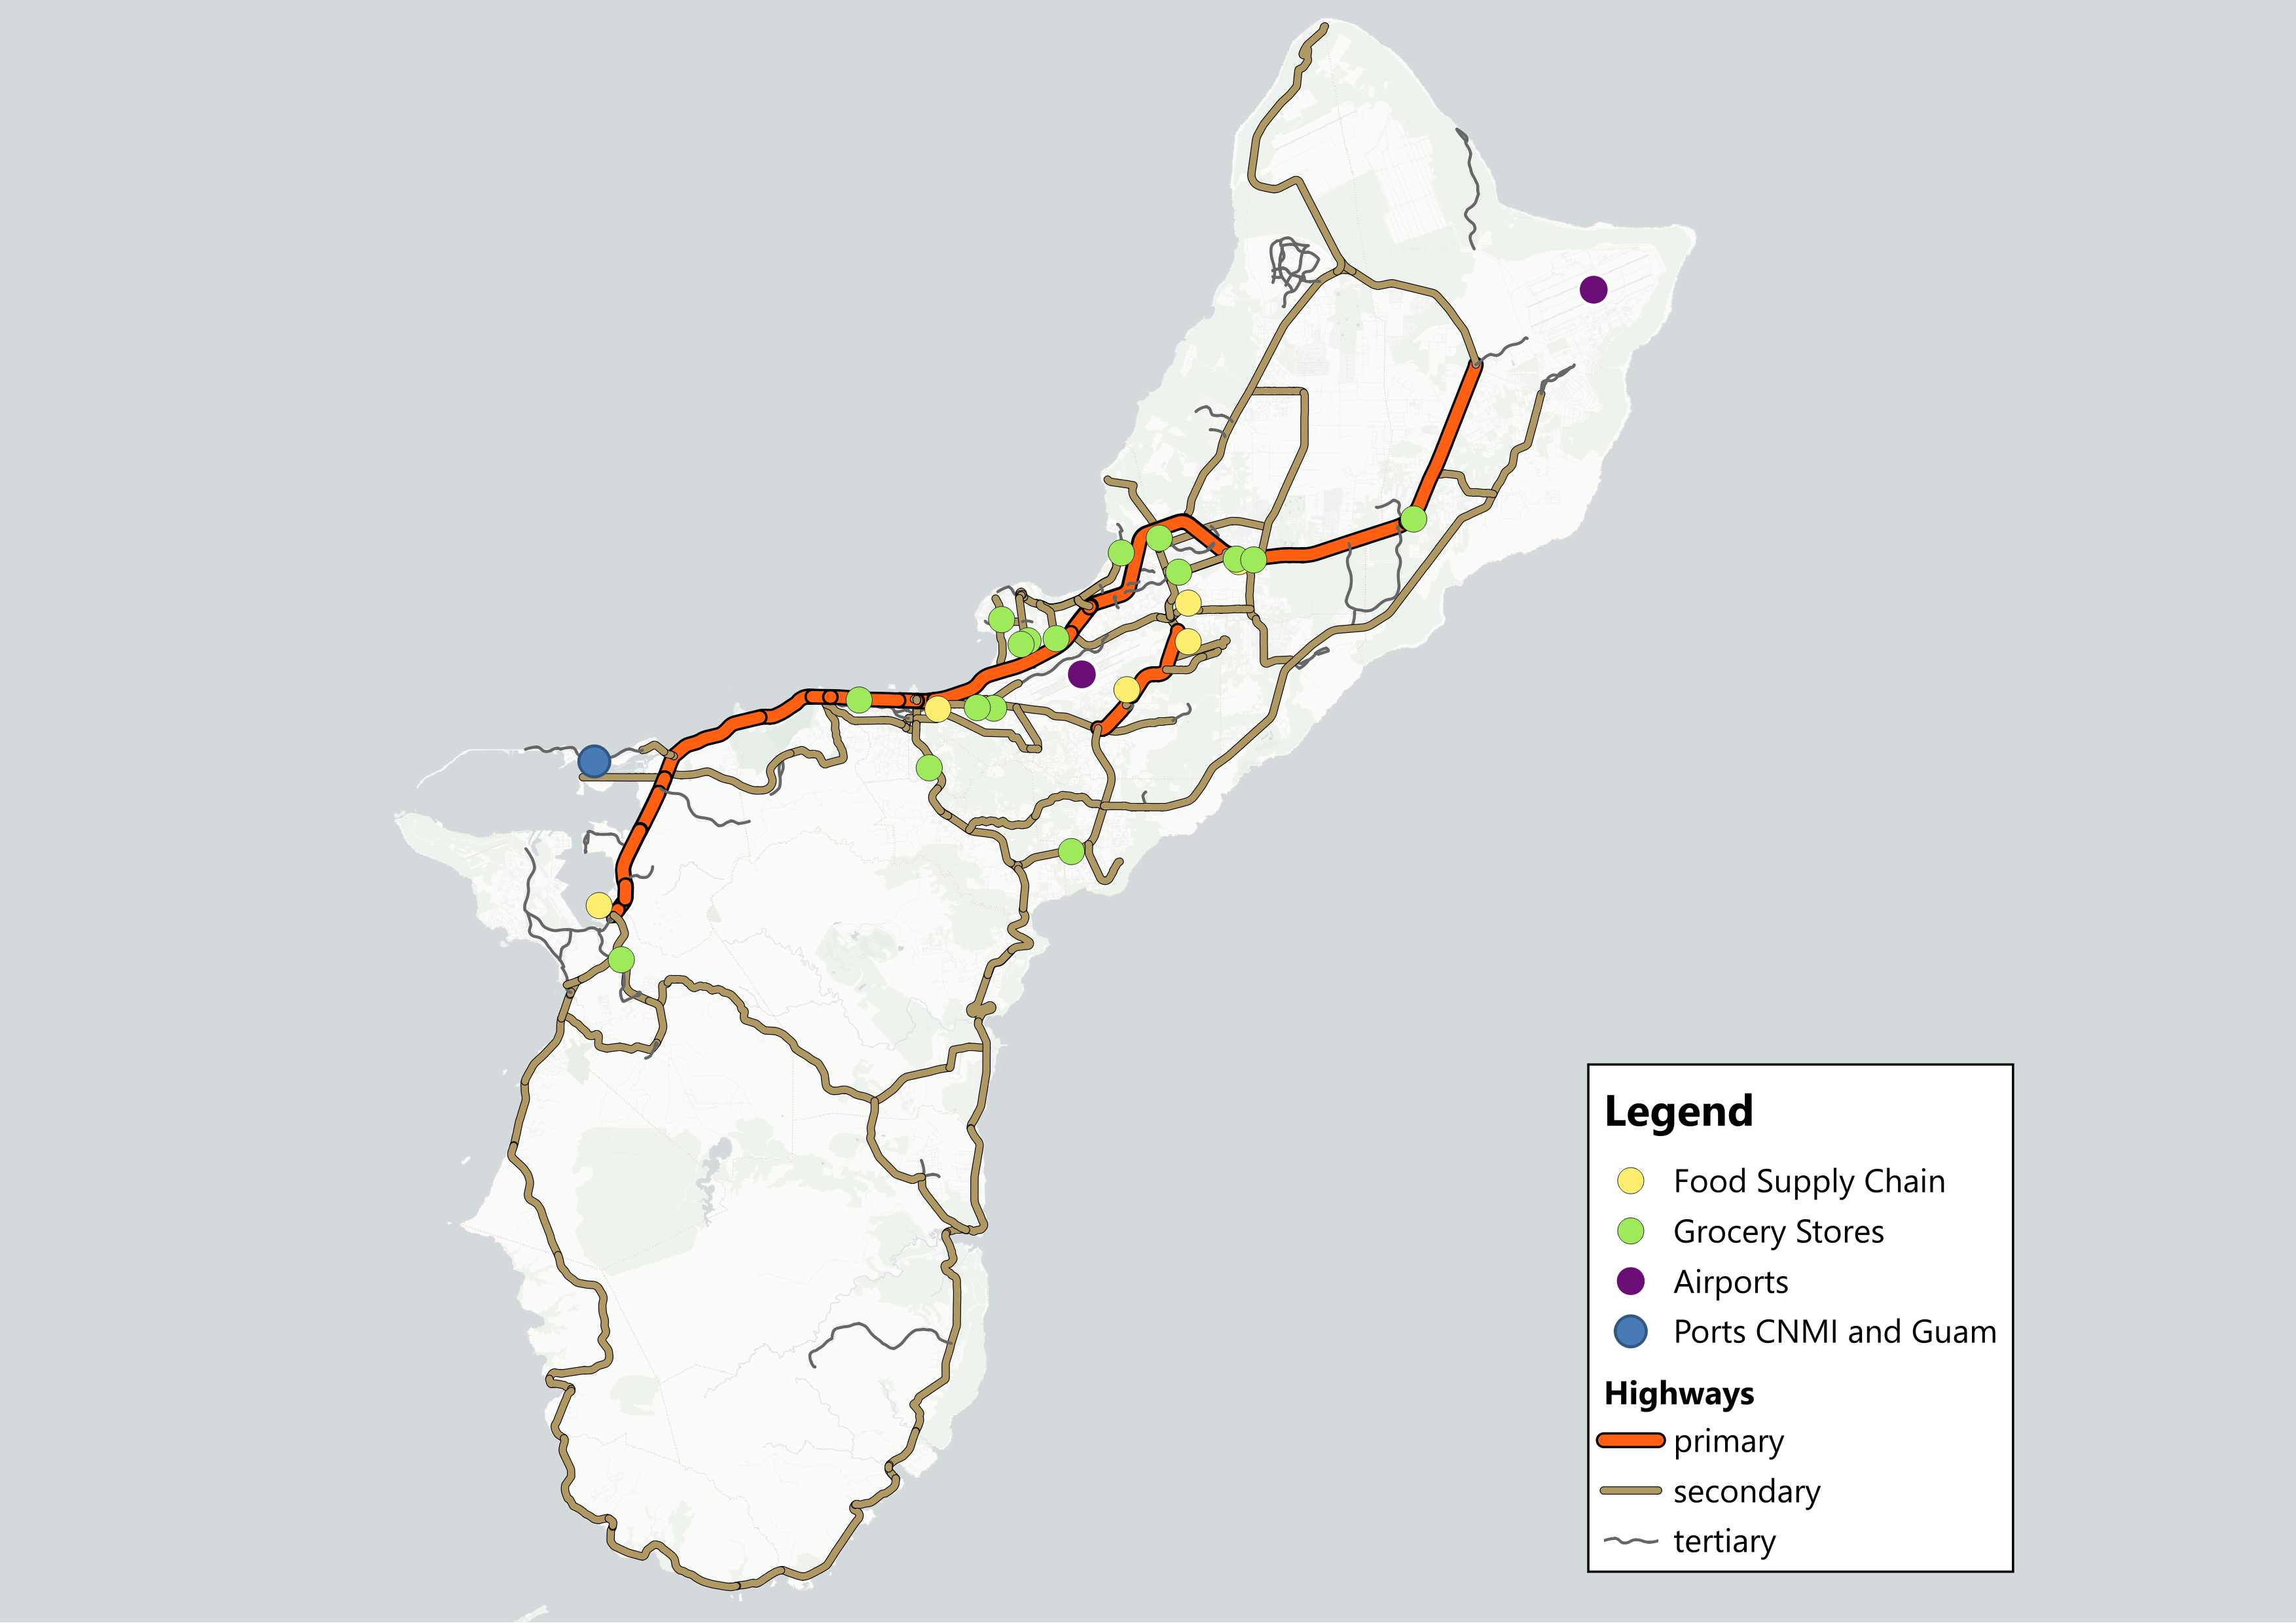
Critical Infrastructure & Commodity Flows: Food
BEAD Tier 1 Report
Guam’s food supply is primarily maritime, with most goods arriving from the U.S. mainland via scheduled container service
Recent food shipments:
APL Islander — Apr 6 (07:28 ChST)
Kaimana Hila (Matson) — Apr 7 (20:48 ChST)
Next scheduled food shipment:
APL container service — Apr 12
APL container service — Apr 19
Matson weekly service (Tuesday rotation)
Food supply posture:
~2 weeks on-island inventory, supported by weekly container shipments
Key risk:
Missed vessel offload window due to port conditions
Retail restocking delays, even with adequate bulk supply
Power outages → spoilage risk for refrigerated goods
Guam
Sources: APL Shipping Schedules; Matson Guam Service; Vessel AIS (MarineTraffic/VesselFinder); Guam SCAN Baseline Assessment
Notes:
Should Answer: What goods generally flow through (or originate and terminate in) the impacted area? What freight modes are used?

Slide 25
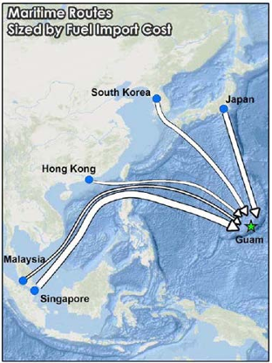
Ripple Forecast: Guam
Supply Chain Context
Guam’s food and fuel supply is fully dependent on maritime imports through a single port
Shipments operate on fixed weekly cycles with limited surge capacity
Power and communications systems are critical enablers of distribution and commerce
Missed/delayed port deliveries and utility outages will provide the most risk and should be closely monitored
Potential Impact Timeline
0–3 Days (During Storm / Immediate Aftermath)
Port operations paused or restricted
Widespread power outages and communications disruption
Initial breakdown in fuel distribution and retail operations
3–7 Days (Early Recovery)
Port reopens, but cargo backlog and throughput constraints delay distribution
Communications outages limit coordination (fuel dispatch, trucking, retail restocking)
Fuel and food remain on-island, but access and distribution are constrained
7+ Days (Sustained Disruption Scenario)
Missed or delayed shipments begin to compress supply buffers
Prolonged outages drive spoilage, payment disruption, and reduced business activity
Recovery dependent on power restoration, port throughput, and incoming vessel schedules
Sea Shipping Transit Times to Travel to Guam:
Origin | Transit Time to Guam
Asia | 4–6 days
Hawaiʻi | 7 days
West Coast (U.S.) | 13 days
Sources: Guam Power Authority; Guam SCAN Baseline Assessment; Port Authority of Guam
Notes:
Should Answer: What forecasted impacts can the U.S. national economy expect over the next 3 days, 2 weeks, and 3 months as a result of this incident?

Slide 26
Socio-Economic Profile: Guam
Guam’s population is moderately vulnerable to prolonged disruption, with economic and demographic factors that increase sensitivity to power outages, supply chain interruptions, and delayed recovery timelines
The 2019 Median Household Income was $58,289, compared to $81,604 nationally. *
16.8% of families have income that falls below the poverty level.*
7.7% of households earn less than $10,000, and 20.1% earn less than $25,000*
20,836 Renter - occupied housing units (48% of all housing units)*
411 Mobile homes (0.8% of all housing units)*
Socio-demographics Information: Guam
 | Number of people | % of Population
Total Population for Guam | 153,836 | 100%
Population Under Age 5 | 10,626 | 6.9%
Population Under Age 18 | 41,487 | 27.0%
Population 65 and Over | 9,211 | 6.0%
Population with a Disability* | 19,086 | 13.3%
Education level below High School Diploma* | 12,773 | 14.0%
Unemployed* | 6,570 | 5.9%
*excluding military housing units
Sources: U.S. Census (2020 Island Areas); Guam Bureau of Statistics and Plans
Notes:
Should Answer: Are there any notable socio-economic indicators relevant to the population impacted by a given incident?

Slide 27
Appendix

Slide 28
Data Sources
Source | Link | Use Case
NOAA / NWS Guam | Typhoon Sinlaku forecast products and statements | Wind, rainfall, timing, flood/landslide risk
FEMA Western Pacific IAB | Tropical Activity Western Pacific – 09 Apr 2026 | Operational posture, critical considerations, pre-positioning context
U.S. Coast Guard | Sinlaku port condition releases for the Marianas | X-Ray / Yankee / Zulu timelines; cargo-operating restrictions
Port Authority of Guam | Storm updates and harbor master shipping schedules | Port status, tanker and container schedules, cargo posture
APL | Guam port schedules; Saipan port schedules; Guam-Saipan Express schedules | Upcoming Guam and Saipan container calls
Matson | Guam Service / Micronesia schedule | Upcoming Guam, Saipan, and Tinian container calls
Guam SCAN Slides | Pacific Supply Chain Risk and Vulnerability Analysis: Guam | Guam food, fuel, port, road, and airport narrative
Guam Pacific Baseline Assessment | Guam Supply Chain Baseline | Guam commodity flows, food sourcing, fuel movement, transport chokepoints
CNMI SCAN Slides | Critical Commodity Lifelines Baseline Assessment: CNMI | CNMI hub structure, outer-island vulnerability, lifeline context
CNMI Pacific Baseline Assessment | Commonwealth of the Northern Mariana Islands Supply Chain Baseline | CNMI food and fuel flows, port/airport/inter-island dependencies
DOE | Territory Sector Risk Profile – Guam | Guam fuel storage, energy dependence, distribution structure
NREL / EIA | CNMI Energy Baseline / EIA CNMI profile | Saipan/Tinian/Rota fuel storage days; energy dependence
Guam Catastrophic Typhoon Plan | 2018 Guam Catastrophic Typhoon Plan | Guam food buffer planning assumption
CNMI Catastrophic Typhoon Plan | 2017 CNMI Catastrophic Typhoon Plan | CNMI food buffer planning assumption
IMPLAN | Guam and CNMI models | GDP, headliner industries, workforce concentration
U.S. Census / Island Areas Census | Guam and CNMI demographic tables | Socio-economic profiles
Open Street Map | Map figures | Highways mapping
NTAD/USACE | Map figures | Port/Airport locations mapping

